Slide 1
Introduction to Python
Some materials based on the python tutorial slides by Guido van Rossum @ZOPE inc and Chen Lin @Brandeis.
Jianwei Liu

Slide 2
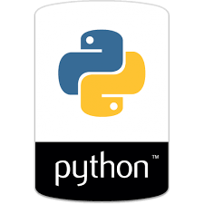
Why Python
A popular interpreted high level language (easy, versatile)
General purpose (data analytics, machine learning, visualization, web, mobile app, etc.)
A lot of modules (numpy, Twisted, Request, matplotlib)
Support several programming paradigms (imperative, OO, functional)
Simple - zen of python
Notes:
Python is an interpreted, interactive, object-oriented programming language. It incorporates modules, exceptions, dynamic typing, very high level dynamic data types, and classes. Python combines remarkable power with very clear syntax. It has interfaces to many system calls and libraries, as well as to various window systems, and is extensible in C or C++. It is also usable as an extension language for applications that need a programmable interface. Finally, Python is portable: it runs on many brands of UNIX, on the Mac, and on PCs under MS-DOS, Windows, Windows NT, and OS/2.

Slide 3


Agenda
Basic Syntax
Statement & Variable & Operators
Control Structure
Exceptions
Input & Output
Using functions & Libraries
Built-in types and containers
Function & Class
Modules & Packages

Slide 4
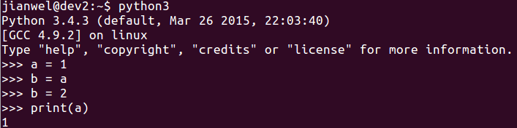
Interactive shell
Good for learning and testing
Python version we will use 3.5.2

Slide 5
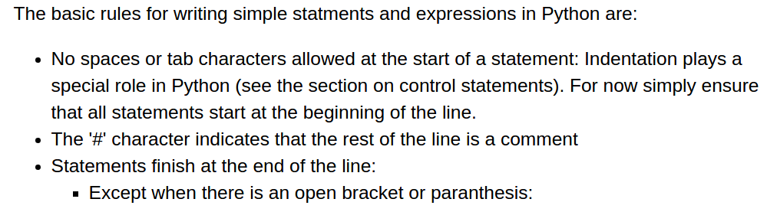
Statements
X = 1
X = “Hello”
No semicolon needed as in C-like languages

Slide 6
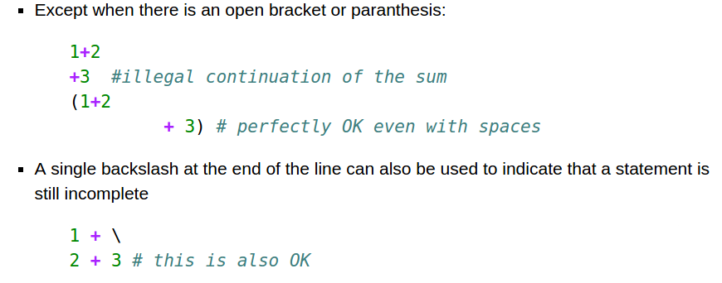
Statements - multiple lines

Slide 7
Variable
X = 1
X = “Hello”
print (X)
The principal built-in types are numerics, sequences, mappings, classes, instances and exceptions.
Immutable: numerics, string, tuple,unicode
Mutable list, dict, set, user defined types
duck typing,If it looks like a duck, swims like a duck, and quacks like a duck, then it probably is a duck.

Slide 8
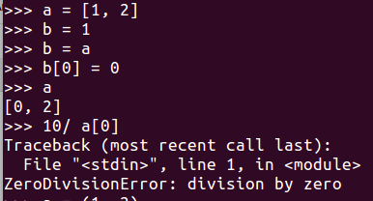

Variable
Everything is a reference, be cautious when mutable!!

Slide 9
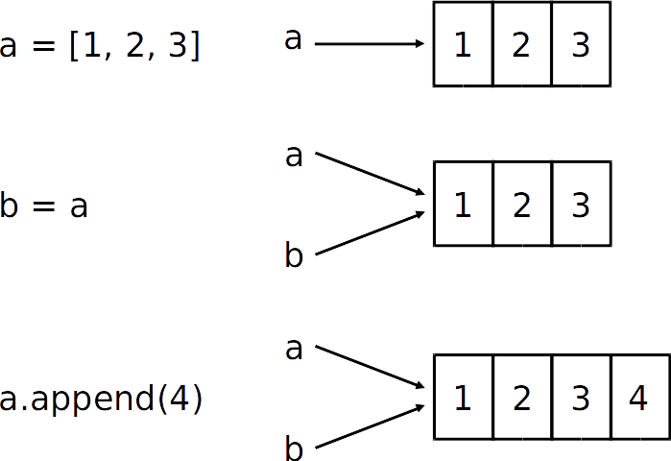
Variable

Slide 10
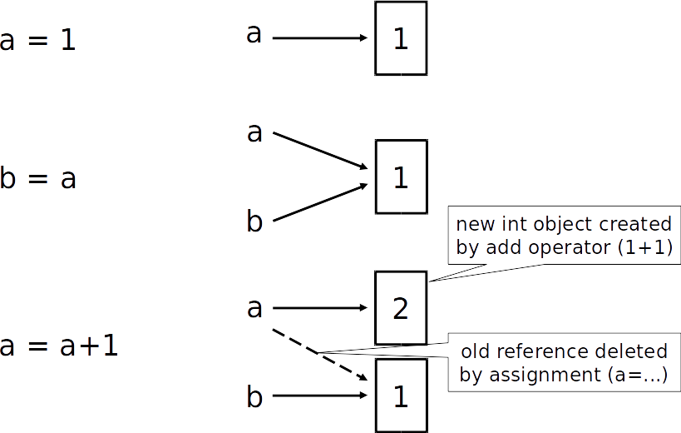
Variable

Slide 11
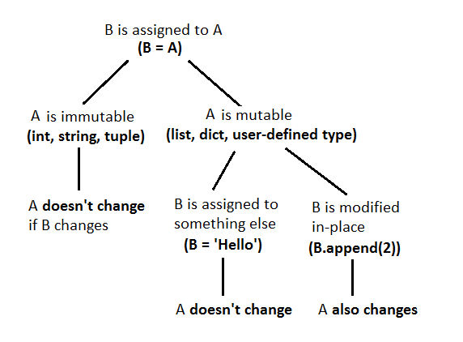
Variable

Slide 12
Variable - numerics
int, float, complex
From string to int: int()
From int to string: str()

Slide 13
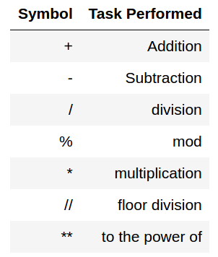
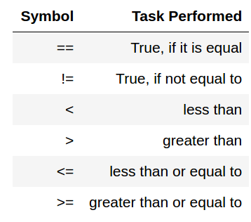
Operators
Quiz: what is the result of 3 / 4 in python 3

Slide 14
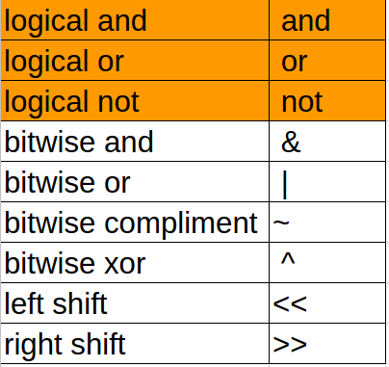
Logical and Bitwise Operators
Logical xor: bool(a) != bool(b)
Logical expression the same as C like language:
<, >, <=, >=, ==, !=

Slide 15
Control Structures
if condition:
statements
[elif condition:
statements] ...
[else:
statements]
while condition:
statements
for var in sequence:
statements
Note: Indentation
break; continue - The same like C-like language

Slide 16
range()
“range” creates a list of numbers in a specified range
range([start,] stop[, step]) -> list of integers
When step is given, it specifies the increment (or decrement).
>>> range(5)
[0, 1, 2, 3, 4]
>>> range(5, 10)
[5, 6, 7, 8, 9]
>>> range(0, 10, 2)
[0, 2, 4, 6, 8]
Quiz: How to get every second element in a list?
Some other functions: zip, sort, reserved, enumerate, etc.
for i in range(0, len(data), 2):
print data[i]

Slide 17
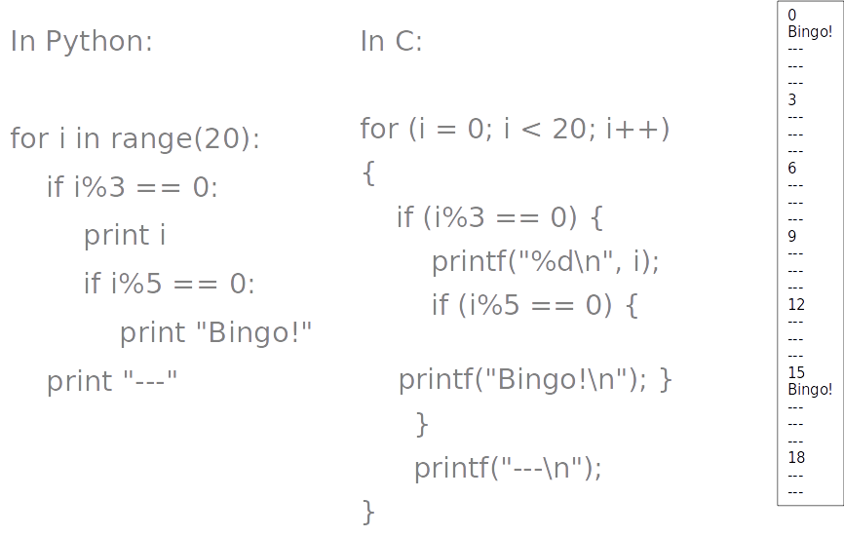
Nested Blocks

Slide 18
Exception
try:
body
except SomeException, OptionalMessage:
print(“2”)
[else:
print(“3”) ]
[finally:
print(“4”)]

Slide 19
Exception
def foo(x):
return 1/x
def bar(x):
try:
print foo(x)
except ZeroDivisionError, message:
print "Can’t divide by zero:", message
bar(0)

Slide 20
Raise exception
raise IndexError
raise IndexError("k out of range")
raise IndexError, "k out of range"
try:
something
except: # catch everything
print "Oops"
raise # reraise

Slide 21
Exception - reference
https://docs.python.org/3.5/library/exceptions.html

Slide 22
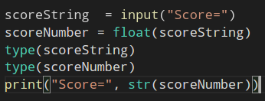
Input

Slide 23
File operations
with open("x.txt") as f: data = f.read() do something with data
Using with will guarantee the file is closed even if any exception.
The with statement is used to wrap the execution of a block with methods defined by a context manager. This allows common try...except...finally usage patterns to be encapsulated for convenient reuse.

Slide 24
File operations - shorter
>>> lst= [ x for x in open("text.txt","r").readlines() ]
>>> lst
['Chen Lin\n', 'clin@brandeis.edu\n', 'Volen 110\n', 'Office Hour: Thurs. 3-5\n', '\n', 'Yaqin Yang\n', 'yaqin@brandeis.edu\n', 'Volen 110\n', 'Office Hour: Tues. 3-5\n']
Ignore the header?
for (i,line) in enumerate(open(‘text.txt’,"r").readlines()):
if i == 0: continue
print line

Slide 25
File operations
In [6]: with open("ifile.txt") as ifile:
...: with open("out.txt", 'w') as ofile:
...: for line in ifile:
...: ofile.write(line)
“w” = “write mode”
“a” = “append mode”
“wb” = “write in binary”
“r” = “read mode” (default)
“rb” = “read in binary”

Slide 26
String
"hello"+"world" "helloworld" # concatenation
"hello"*3 "hellohellohello" # repetition
"hello"[0] "h" # indexing
"hello"[-1] "o" # (from end)
"hello"[1:4] "ell" # slicing
len("hello") 5 # size
"hello" < "jello" True # comparison
"e" in "hello" True # in operator
“a” not in “hello” True
Note all these in this page can be used with tuple and list

Slide 27
String
"escapes: \n etc, \033 etc, \if etc"
'single quotes' """triple “hello” quotes""" r"raw strings" "\\n" == r"\n"

Slide 28
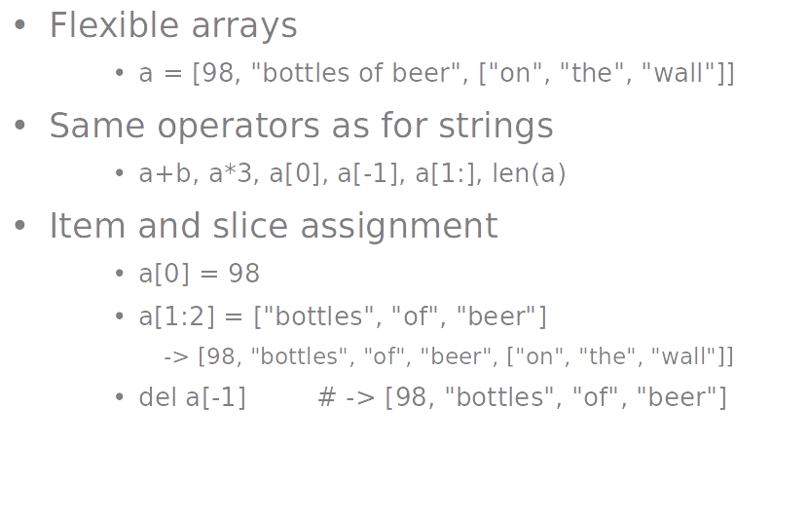
List

Slide 29
List
>>> a = range(5) # [0,1,2,3,4]
>>> a.append(5) # [0,1,2,3,4,5]
>>> a.pop() # [0,1,2,3,4]
5
>>> a.insert(0, 42) # [42,0,1,2,3,4]
>>> a.pop(0) # [0,1,2,3,4]
5.5
>>> a.reverse() # [4,3,2,1,0]
>>> a.sort() # [0,1,2,3,4]

Slide 30
Tuples
key = (lastname, firstname)
point = x, y, z # parentheses optional
x, y, z = point # unpack
lastname = key[0]
singleton = (1,) # trailing comma!!! Or it becomes an int
empty = () # parentheses!
tuples vs. lists; tuples immutable

Slide 31
Copy the whole sequence
A = [1, 2, 3]
B = A [:]

Slide 32
Dictionary
Dictionaries are lookup tables.
They map from a “key” to a “value”.
symbol_to_name = {
"H": "hydrogen",
"C": "carbon",
"O": "oxygen"
}
Duplicate keys are not allowed
Duplicate values are just fine

Slide 33
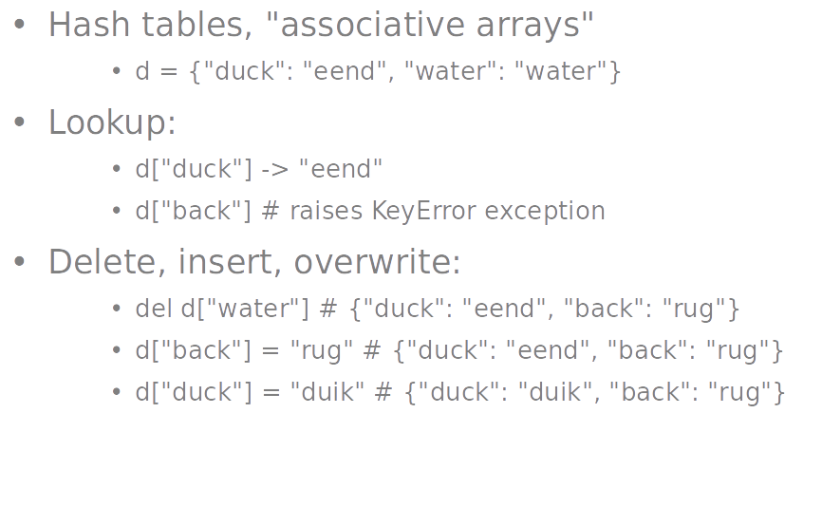
Dictionary

Slide 34
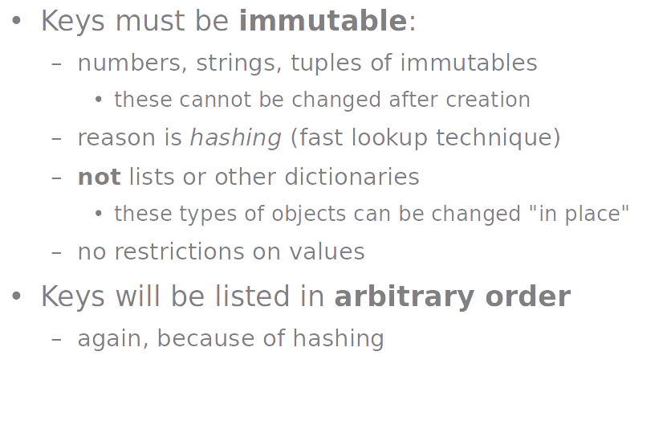
Dictionary

Slide 35
Function
def name(arg1, arg2, ...):
"""documentation""" # optional doc string
statements
return [value] -> if not value used, return None, but used as break in loops. It is not recommended to catch or use the value
return None
No explicit return expression -> still return None

Slide 36
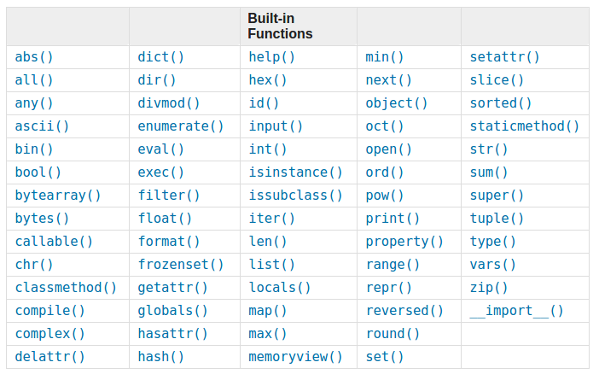
Built-in function (python3.5)

Slide 37
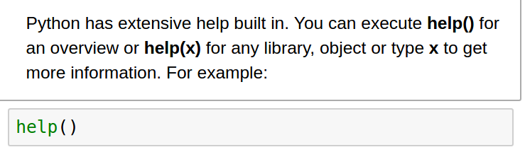
Built-in function - help()

Slide 38
Built-in function
dir()
type()

Slide 39
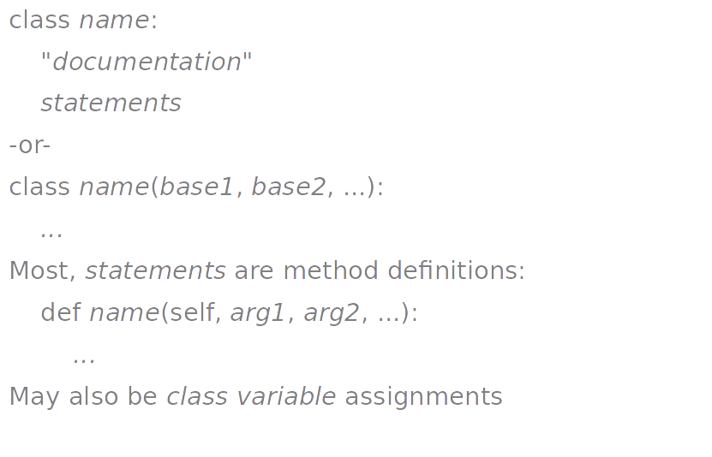
class

Slide 40
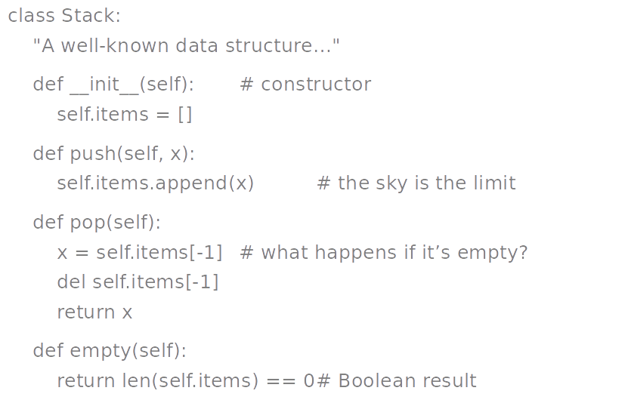
class example

Slide 41
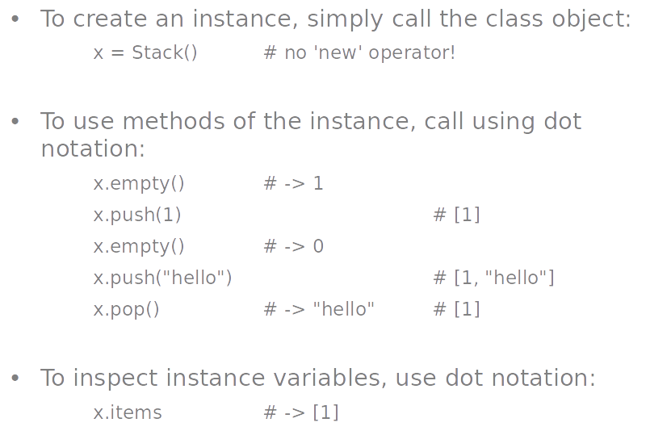
Using class

Slide 42
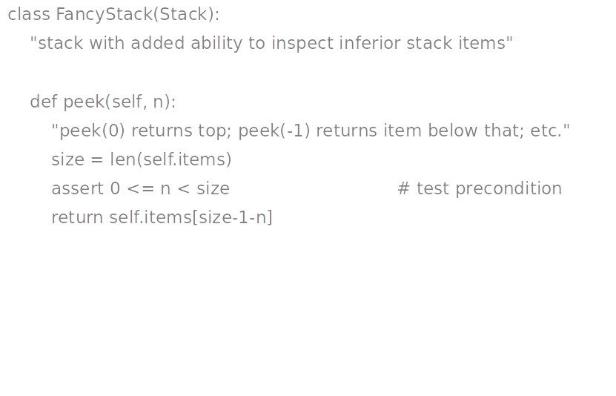
Subclass

Slide 43
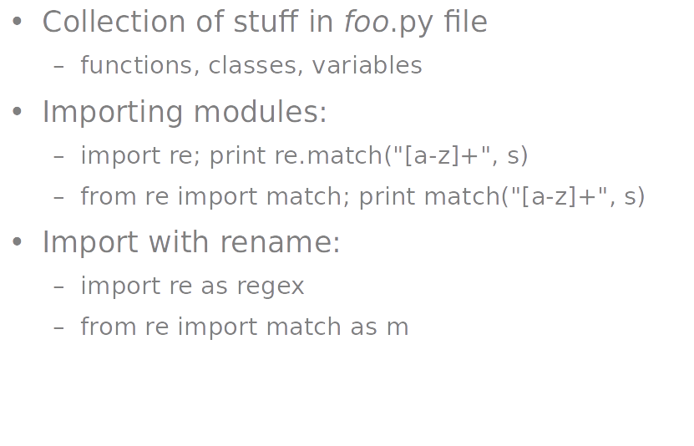
Modules

Slide 44
Packages
Collection of modules in directory
Must have __init__.py file, can be empty.
May contain subpackages
Import syntax:
from P.Q.M import foo; print foo()
from P.Q import M; print M.foo()
import P.Q.M; print P.Q.M.foo()
import P.Q.M as M; print M.foo()
P - Package Name Q- Sub-Package Name
M- Module Name

Slide 45
Tips
Do not put pyc files into your version control repositories.
GUI: VSCODE, pycharm, ATOM, IDLE
List comprehension, generator, global and variable scope, details about class like protected or private

Slide 46
Questions?

